Slide 1
Android Botnet Detection Using Machine Learning
Vidyavardhini’s College of Engineering & Technology
K.T. Marg, Vartak College Campus, Vasai Rd, Vasai-Virar, Maharashtra 401202
Department of Artificial Intiligence and Data Science
Group No:
Yash Patil (18)
Chetan Sapkal (37)
Shubhamkar Patra(35)
Project Guide: Mrs. Sneha Yadav
Date: 14/03/2023

Slide 2
Contents
Problem statement
Advancement in Technology pertaining to the selected project topic
literature review
SRS
Model
Design
References

Slide 3
Problem Statement
Our proposed botnet detection system is implemented as an SVM-based model that is trained on 342 static app features to distinguish between botnet apps and normal apps.
However, because of the recent information explosion, information security has become a crucial topic, even in relation to the IoT.

Slide 4
Advancement in Technology pertaining to the selected project topic
Smart phone users still blindly trust applications and default settings of smart devices and are using them without knowledge of the risk associated with it.
Though mobile botnet is a pretty new concept for users, it is not much known to cyber researchers too.
Our System Is Use To Detect The Bot Net Using SVM Machine Algorithm. And Try to Prevent the Botnet app.

Slide 5
Literature Review
Sr.No | Title | Author | Summary and Drawbacks
1 | DeDroid: A Mobile Botnet Detection Approach Based on Static Analysis -(Aug-2019) | Ahmad Karim; Rosli Salleh; Syed Adeel Ali Shah | Mobile botnet phenomenon is gaining popularity among malware writers in order to exploit vulnerabilities in smartphones. In particular, mobile botnets enable illegal access to a victim's smartphone and can compromise critical user data and launch a DDoS attack through Command and Control (C&C).
2 | Mobile Guard Demo: Network Based Malware Detection -(Aug-2020) | Vikramajeet Khatri; Joerg Abendroth | The growing trend of data traffic in mobile networks brings new security threats such as malware, botnets, premium SMS frauds, etc, and these threats affect the network resources in terms of revenue as well as performance.

Slide 6
Literature Review
Sr.no | Title | Author | Summary and Drawbacks
3 | Mobile botnet detection: Proof of concept -(Aug-2019) | Zubaile Abdullah; Madihah Mohd Saudi; Nor Badrul Anuar | Nowadays mobile devices such as smartphones had widely been used. People use smartphones not limited for phone calling or sending messages but also for web browsing, social networking and online banking transaction.
4 | Mobile Botnet Detection: A Deep Learning Approach Using Convolutional Neural Network -(Jul-2020) | Suleiman Y. Yerima and Mohammed K. Alzaylaee | This calls for more effective methods to detect botnets on the Android platform. Hence, in this paper, we present a deep learning approach for Android botnet detection based on Convolutional Neural Networks (CNN).

Slide 7
Literature Review
Sr.No | Title | Author | Summary and Drawbacks
5 | Smartphone Based Botnet Detection using Behavioral Analysis -(Dec-2020) | Dr.K.Muthumanickam , Dr.R.Shankar , Mr.R.Palanikumar | Today, many applications such as government applications, commercial applications and other applications rely on Internet. Thus, different applications can exchange sensitive user information.
6 | Early Botnet Detection for the Internet and the Internet of Things by Autonomous Machine Learning -(Dec-2020) | Anderson Bergamini de Neira, Alex Medeiros Araujo, Michele Nogueira | The high costs generated by attacks and the increasing number of different devices on the Internet and the Internet of Things (IoT) propel the early detection of botnets (i.e., networks of infected devices) as a way to gain an advantage against attacks.

Slide 8
Literature Review
Sr.no | Title | Author | Summary and Drawbacks
7 | Efficiency of Different Machine Learning Algorithms on the Multivariate Classification of IoT Botnet Attacks -(Oct-2020) | Shreehar Joshi, Eman Abdelfattah School | The Internet of Things, with its enormous growth in the recent decades, has not just brought convenience to the different aspects of our lives.
8 | Towards using Transfer Learning for Botnet Detection -(Dec-2019) | Basil Alothman, Prapa Rattadilok | Botnet Detection has been an active research area over the last decades. Researchers have been working hard to develop effective techniques to detect Botnets.

Slide 9
Literature Review
Sr.No | Title | Author | Summary and Drawbacks
9 | PodBot: A New Botnet Detection Method by Host and Network-Based Analysis -(May-2019) | Somayeh Esmaeili , | The growing use of smart phones equipped with a variety of sensors makes them an ideal place for criminal activities and attacks such as bots.
10 | Towards the Detection of Mobile DDoS Attacks in 5G Multi-Tenant Networks -(Jun-2019) | Ana Serrano Mamolar , Zeeshan Pervez , Jose M. Alcaraz-Calero | The ﬁfth-generation (5G) mobile networks target a variety of new use cases that involve a massive amount of heterogeneous devices connected to the same infrastructure.

Slide 10
SRS
Software Requirement:
Operating system : 64 bit Windows 10.
Coding Language : Python
Frontend : tkinter
Backend : python

Slide 11
HARDWARE REQUIREMENT
System Processors : Core2Duo
Speed : 2.4 GHz
Hard Disk : 500 GB

Slide 12
Model
Support Vector Machine” (SVM) is a supervised machine learning algorithm that can be used for both classification or regression challenges. Support Vectors are simply the coordinates of individual observation. The SVM classifier is a frontier that best segregates the two classes.

Slide 13
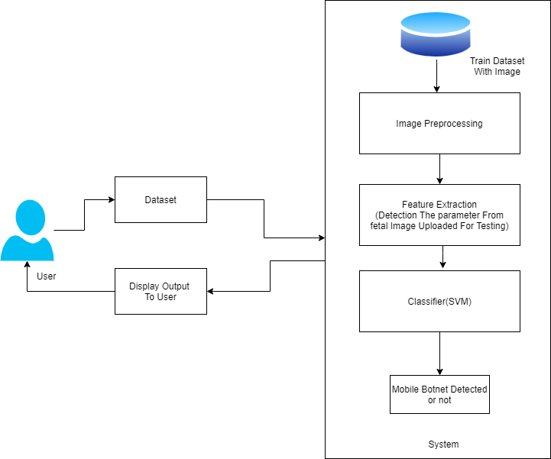
Architecture

Slide 14
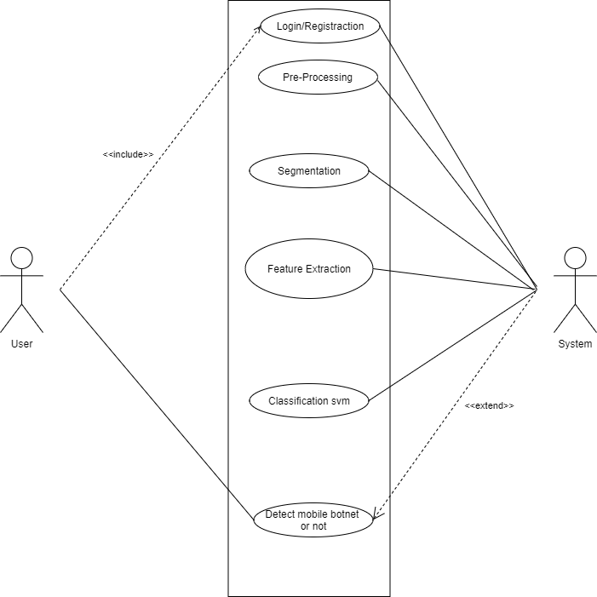
Use case:-

Slide 15
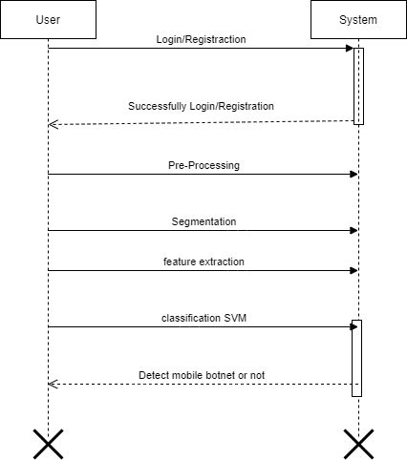
Sequence Diagram:

Slide 16
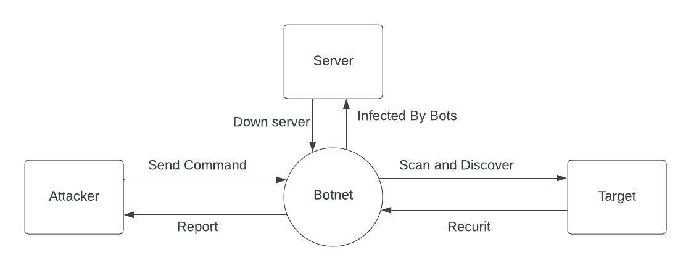
DFD Level 0

Slide 17
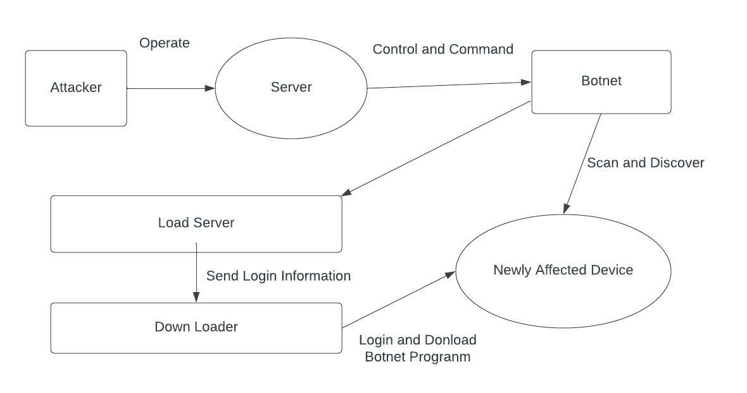
DFD Level 1

Slide 18
Project Timeline Chart:
N.O | TASK | DURATION(Days)
1 | Group Formation | 4
2 | Decide Area Of Interest | 4
3 | Search Topic | 5
4 | Topic Selection | 5
5 | Sanction Topic | 5
6 | Search Related Information | 12
7 | Understanding Concept | 7
8 | Search Essential Document(IEEE & White Paper, Software) | 6
9 | Problem Definition | 2
10 | Literature Survey | 5
11 | SRS | 14
12 | Project Planning | 2

Slide 19
References
1. McAfee Mobile Threat Report Q1. 2020. Available online: https://www.mcafee.com/en-us/consumer-support/2020 mobile threat report.html (accessed on 5 December 2020).
2. Yerima, S.Y.; Khan, S. Longitudinal Performance Analysis of Machine Learning based Android Malware Detectors. In Proceedings of the 2019 International Conference on Cyber Security and Protection of Digital Services (Cyber Security), Oxford, UK,3–4 June 2019.
3. Grill, B.B.; Ruthven, M.; Zhao, X. “Detecting and Eliminating Chamois, a Fraud Botnet on Android” Android Developers Blog. March 2017. Available online: https://androiddevelopers.googleblog.com/2017/03/detecting-and-eliminating-chamois-fraud. html (accessed on 10 December 2020).
4. Chris Brook “Google Eliminates Android Adfraud Botnet Chamois” Threat Post. March 2017. Available online: https://threatpost.com/google-eliminates-android-adfraud-botnet-chamois/124311/ (accessed on 10 December 2020).

Slide 20
5. W. T. Strayer, D. Lapsley, R. Walsh, and C. Livadas, “Botnet detection based on network behavior,” Advances in Information Security, vol. 36, pp. 1–24, 2019.
6. L. Atzori, A. Iera, and G. Morabito, “The internet of things: a survey,” Computer Networks, vol. 54, no. 15, pp. 2787–2805, 2020.
7. M. Feily, A. Shahrestani, and S. Ramadass, “A survey of botnet and botnet detection,” in Proceedings of the 3rd International Conference on Emerging Security Information, Systems and Technologies (SECURWARE ’09), pp. 268–273, June 2021.

Slide 21
Thank You

